Slide 1
Medical Perception Processing using Nlp and Ocr
A powerful Perceptiion processing tool combining OCR with NLP to transform images and PDFs into clean, analyzed text. It extracts content, cleans OCR artifacts, corrects spelling and grammar issues, and provides detailed text analysis.
Notes:
1

Slide 2
Introduction
This powerful document processing tool combines Optical Character Recognition (OCR) and Natural Language Processing (NLP) to transform scanned images and PDFs into clean, structured, and analyzed text.
It extracts content, corrects OCR artifacts, fixes spelling and grammar, and provides deep analysis through readability scoring and entity recognition.
For enhanced results, it offers integration with Google’s Gemini AI, allowing for AI-powered suggestions and improvements.
The system produces a final PDF report containing both the processed text and insights, making it highly useful for students, researchers, and professionals working with medical and academic documents.

Slide 3
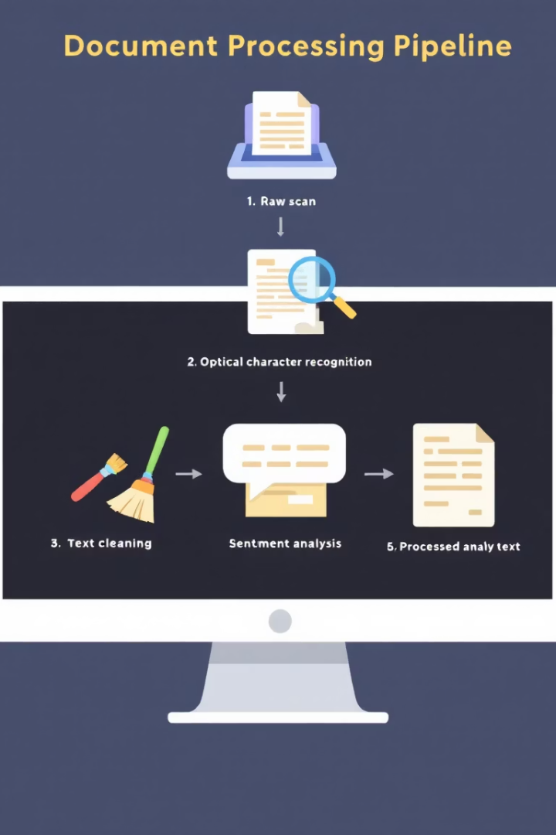


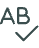

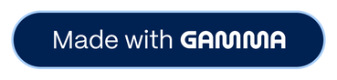
Comprehensive Document Processing Pipeline
Document Extraction
Uses EasyOCR for images and PyMuPDF for PDFs to extract raw text.
Intelligent Cleaning
Applies algorithms to fix common OCR errors and artifacts.
Text Enhancement
Performs spelling correction and grammar enhancement.
Analysis & Reporting
Provides readability metrics and generates comprehensive PDF reports.
Notes:
2

Slide 4

Healthcare Documentation Challenge
Inaccessible Information
Manual Conversion Burden
Integration Gap
Disconnect between paper-based documentation and electronic health records.
Critical patient data trapped in handwritten notes and scanned records.
Time-consuming, error-prone processes divert resources from patient care.
Notes:
3

Slide 5
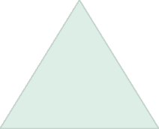

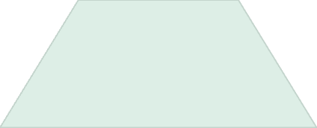
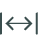
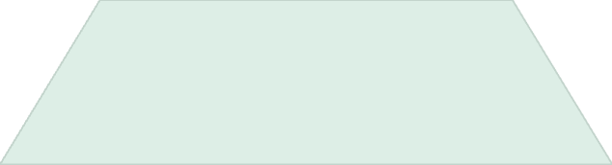

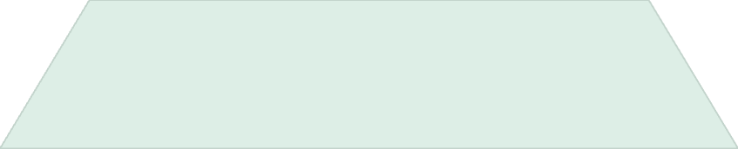

Intelligent Text Processing System
AI Integration
Gemini API for context-aware suggestions
Advanced Analysis
Readability scoring and entity recognition
NLP Processing
Spelling correction and grammar refinement
OCR Foundation
Text extraction from images and PDFs
Notes:
4

Slide 6
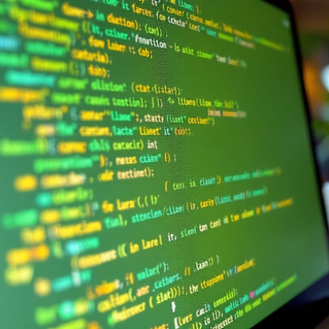
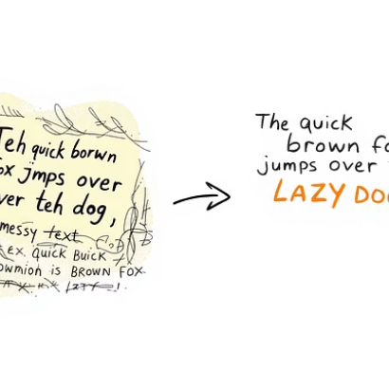
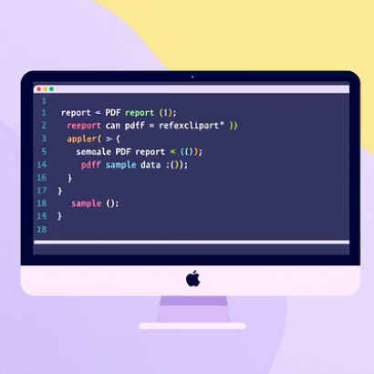
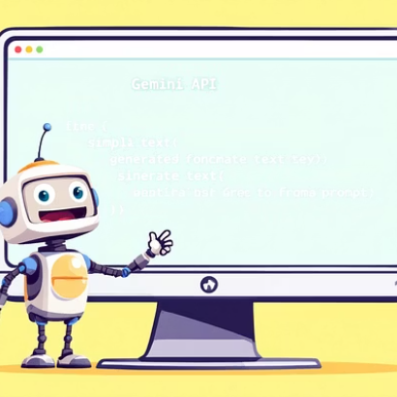
Implementation and Dependencies
The system requires multiple Python libraries including easyocr, PyMuPDF, fpdf, spacy, textstat, and nltk. Google's Gemini AI integration is optional through API key input.
Notes:
5

Slide 7
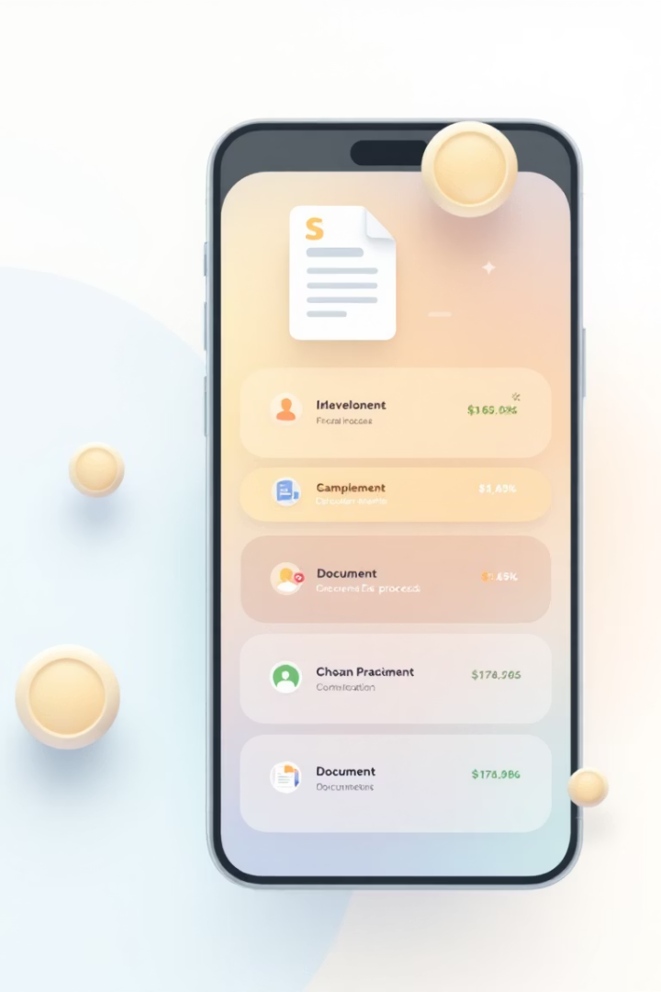
Processing Workflow Demonstration
Document Upload
User uploads image or PDF document for processing.
Text Extraction & Processing
System extracts text, cleans OCR artifacts, corrects spelling and grammar.
Analysis & Enhancement
Text undergoes readability analysis, entity recognition, and optional AI improvement.
Report Generation
System compiles results into downloadable PDF with processed text and analysis.
Notes:
6

Slide 8





Key Advantages
Automation of Manual Work
Robust NLP Processing
Reduces need for manual transcription of medical documents.
Applies multiple techniques to produce clear, structured text.
Readability Analysis
Custom PDF Reports
Provides scores to assess content comprehension difficulty.
Generates organized reports with processed text and insights.
Notes:
7

Slide 9








Limitations to Consider
Image Quality Dependency
Handwriting Challenges
Lower accuracy with complex or cursive handwriting.
Poor quality scans reduce OCR accuracy.
Resource Intensity
Medical Term Confusion
Large documents require significant processing power.
Spell correction may misinterpret specialized terminology.
Notes:
8

Slide 10
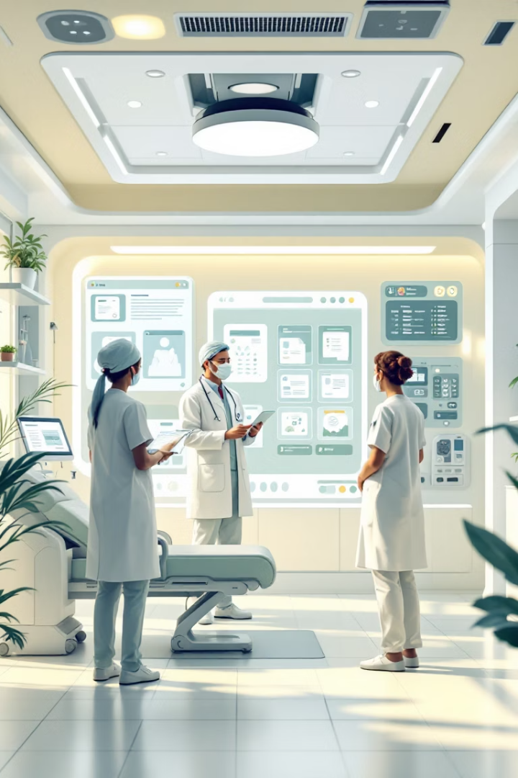




Future Impact on Healthcare Documentation
Improved Efficiency
Reduced manual processing time for clinical documentation.
Enhanced Data Access
Better integration between paper records and digital systems.
Research Advancement
Unlocked insights from previously inaccessible documentation.
Better Patient Care
More complete information available at point of care.
Notes:
9

Slide 11
conclusion
The developed system bridges the gap between raw medical documents and meaningful digital insights by combining OCR and advanced NLP techniques.It automates the extraction, cleaning, and analysis of unstructured text from images and PDFs, minimizing manual effort and reducing errors in clinical documentation.With features like readability scoring and AI-driven suggestions, the tool enhances the clarity and accessibility of digitized content.Overall, this solution streamlines healthcare data processing and sets the foundation for scalable, intelligent documentation systems in the medical field.

